Slide 1




A
NEXT GEN EMPLOYABILITY PROGRAM
Creating a future-ready workforce
Team Members
College Name
Arunachala College of Engineering
for Women
Student Name :S. Abisha
Student ID : 960221104006

Slide 2

CAPSTONE PROJECT SHOWCASE
Project Title
Car Rentals Application with Django Framework
Abstract | Problem Statement | Project Overview | Proposed Solution | Technology Used | Modelling & Results | Conclusion

Slide 3
Abstract
The Car Rentals Application is a web-based platform developed using the Django framework, designed to streamline the process of renting vehicles for users and managing the rental fleet for administrators. The application facilitates seamless interaction between car rental companies and their customers, providing an intuitive interface for browsing available vehicles, making reservations, and managing bookings.
Car Rentals Application offers a comprehensive solution for car rental businesses to digitize their operations, enhance customer satisfaction, and increase operational efficiency. Through its intuitive interface, robust features, and scalable architecture, the application caters to the needs of both users and administrators in the car rental industry.
Administrators can add, update, or remove vehicles from the rental fleet . Each vehicle listing includes details such as make, model, year, rental price, and availability . Advanced search and filtering options enable users to find specific vehicles based on criteria like brand, model, or price range.
Source :

Slide 4
Problem Statement
User Authentication and Authorization:
Secure user registration, login, and role-based access control to ensure data security and privacy compliance.
Vehicle Inventory Management:
Centralized platform for adding, updating, and managing vehicle listings, including details such as availability, pricing, and specifications.
Booking System:
Intuitive interface for users to browse available vehicles, make reservations, and receive confirmation emails for successful bookings.
Rental History and Profile Management:
User profiles to track rental history, manage personal information, and preferences for a personalized experience.
Admin Dashboard:
Centralized dashboard for administrators to monitor bookings, manage inventory, and access comprehensive reporting and analytics tools.
Source :

Slide 5
Project Overview
Transition traditional car rental processes into a digital platform to improve efficiency, accuracy, and
customer experience.
Provide customers with an intuitive interface to browse available vehicles, make reservations, and manage bookings conveniently online.
Enable administrators to efficiently manage vehicle inventory, monitor bookings, and analyze rental performance through centralized tools.
Implement robust security measures to protect customer data and ensure compliance with privacy
regulations.
Leverage data analytics and reporting capabilities to identify opportunities for optimization, expansion, and revenue growth within the car rental industry.
Provide ongoing maintenance, updates, and technical support to address issues, add new features, and improve application performance.
Source :

Slide 6
Proposed Solution
.
The proposed solution is a comprehensive Car Rentals Application developed using the Django framework. It aims to address the challenges faced by traditional car rental businesses by providing a modern, user-friendly, and efficient platform for managing vehicle rentals.
Key Components and Features:
User Authentication and Authorization:
Secure user registration and login system.
Role-based access control for customers and administrators.
Vehicle Inventory Management:
CRUD operations for adding, updating, and removing vehicles from the rental fleet.
Detailed vehicle listings with specifications, availability status, and rental rates.
Booking System:
Intuitive interface for customers to search for available vehicles based on criteria such as location, dates, and vehicle type.
Booking functionality allowing customers to reserve vehicles for specific dates and times.
Source :

Slide 7
4.Rental History and Profile Management:
User profiles enabling customers to view their rental history, manage personal information.
5.Admin Dashboard:
Centralized dashboard for administrators to manage vehicle inventory, bookings, and customer accounts.
Reporting and analytics tools to track rental performance, revenue, and customer trends.
6.Payment Integration:
Secure payment gateway integration to facilitate online transactions securely.
Support for multiple payment methods including credit/debit cards, PayPal, and other digital wallets.
7.Responsive Design:
Mobile-friendly and responsive design ensuring accessibility across various devices and screen sizes.
Enhanced user experience through intuitive navigation and optimized layouts.
8.Data Security and Compliance:
Implementation of robust security measures to protect customer data and ensure compliance with privacy regulations such as GDPR.
Encryption of sensitive information during transmission and storage.
Source :

Slide 8
Development Approach:
Requirement Gathering:
Conduct stakeholder meetings and market analysis to gather requirements and identify business needs.
2.Design Phase:
Create wireframes, UI/UX designs, and database schemas based on the gathered requirements.
3.Development:
Implement the application logic, frontend interfaces, backend functionalities, and database integration using Django.
4.Testing:
Conduct thorough testing including unit tests, integration tests, and user acceptance tests to ensure functionality, security, and usability.
5.Deployment:
Deploy the application to a production environment, configure server settings, and perform load testing to ensure scalability and performance.
6.Maintenance and Support:
Provide ongoing maintenance, updates, and technical support to address issues, add new features, and improve application performance.
Source :

Slide 9


Technology Used
Front-end
Back-end
Source :

Slide 10
Modelling & Results
Modeling :
User Model
Vehicle Model
Booking Model
Admin Model
Payment Model
Results :
User Authentication and Authorization
Vehicle Inventory Management
Rental History and Profile Management
Source :

Slide 11
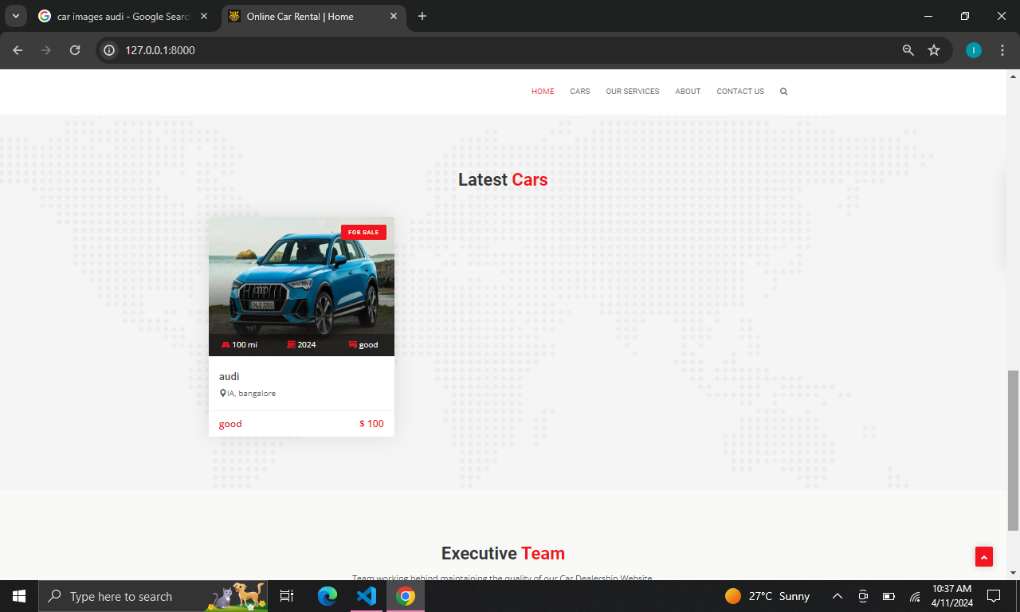
Homepage

Slide 12
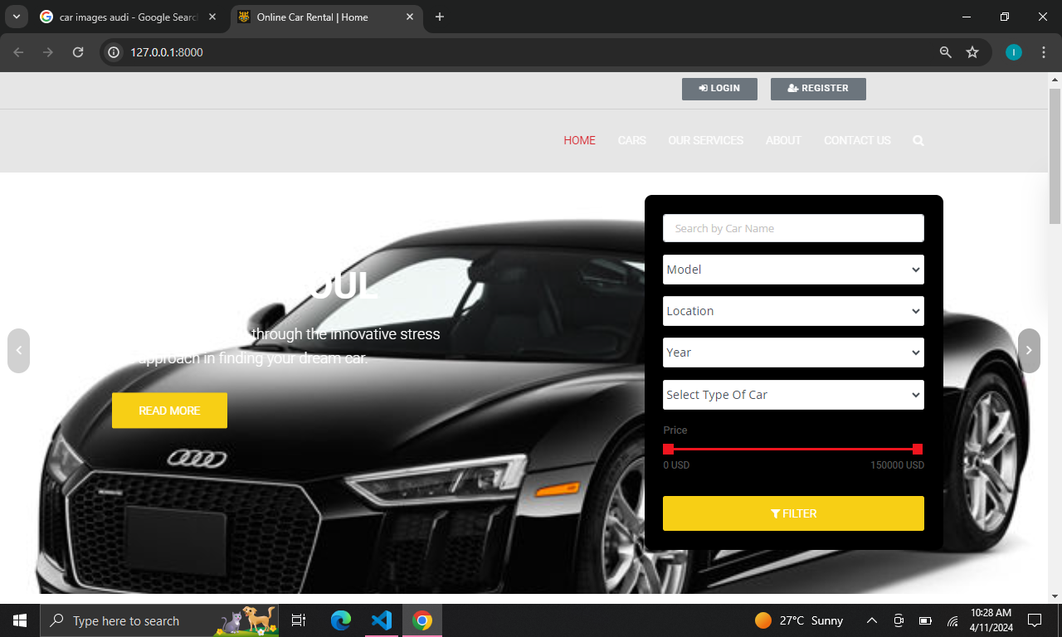
Homepage

Slide 13
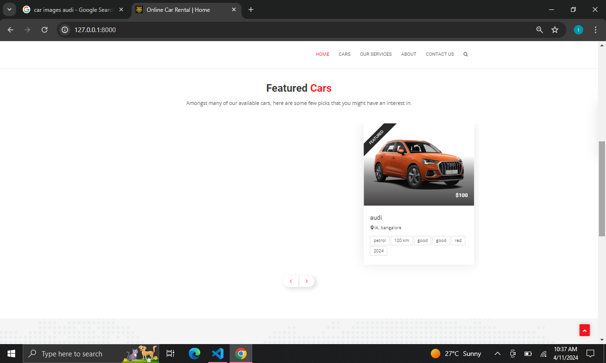
Homepage

Slide 14
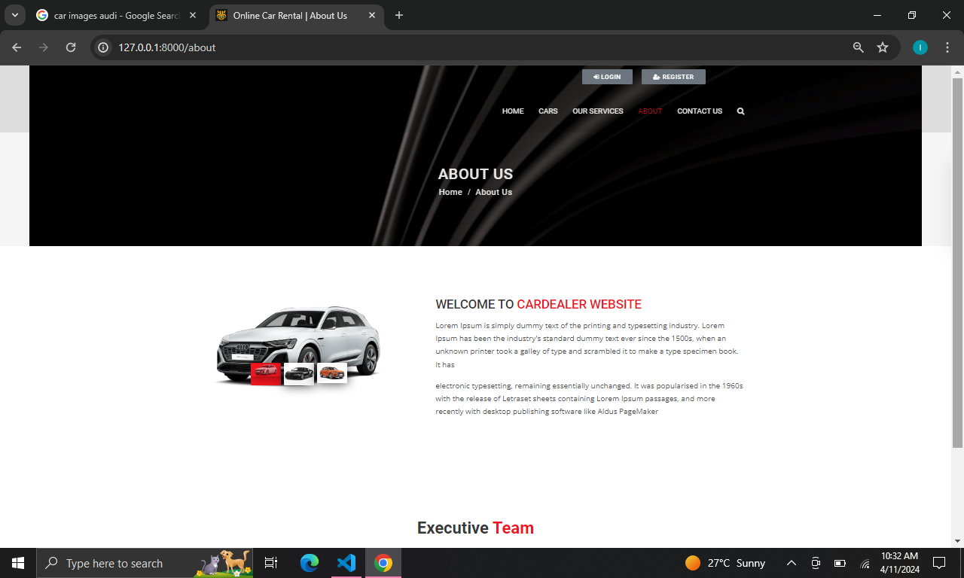
About-Us-Page

Slide 15
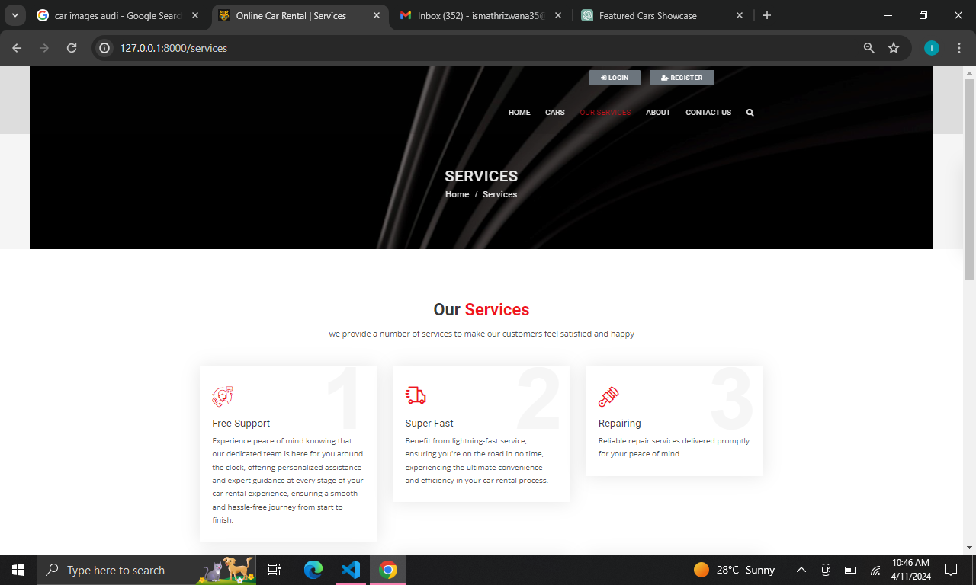
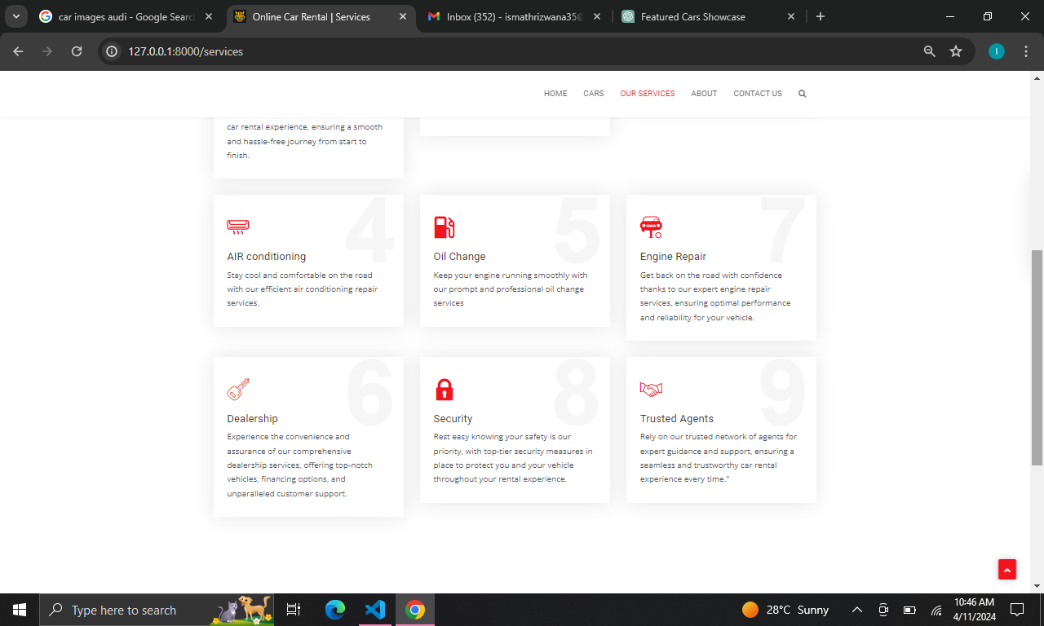
Service-Page

Slide 16
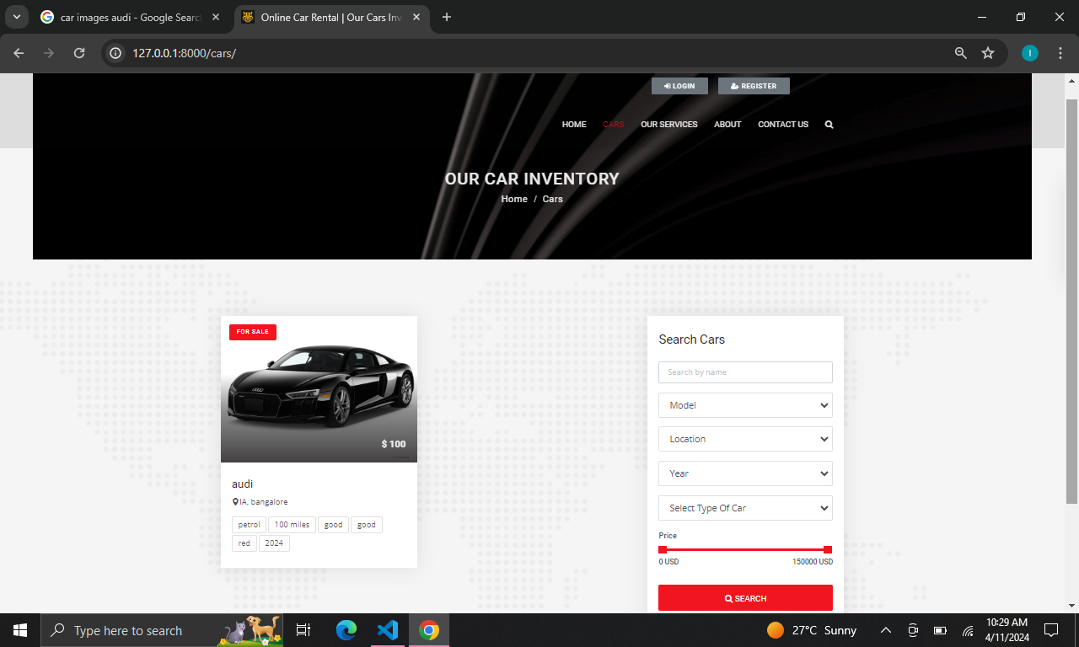
Car-Page

Slide 17
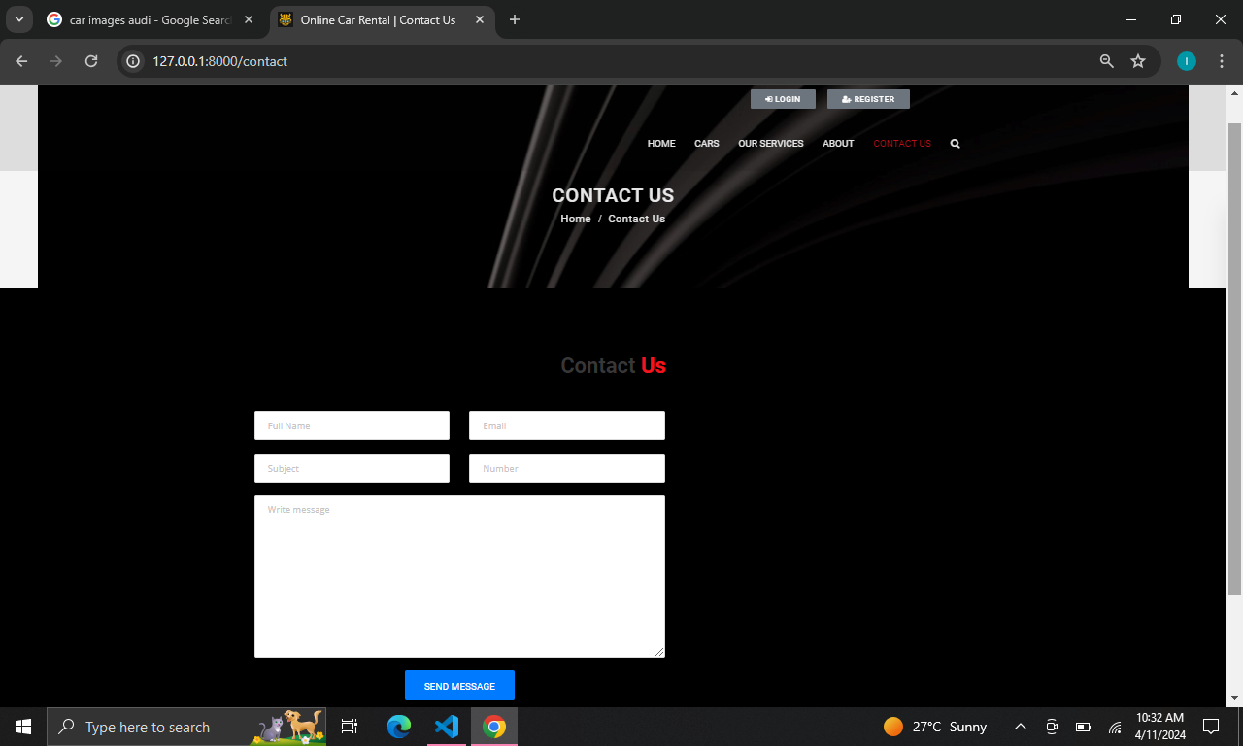
Contact page

Slide 18
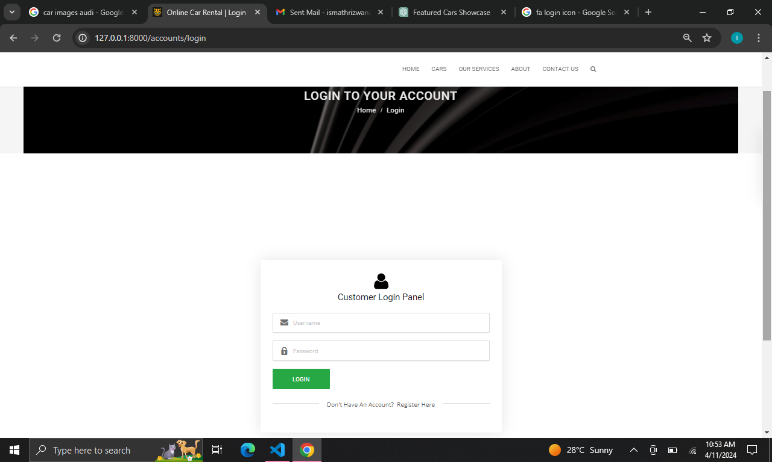
Login page

Slide 19
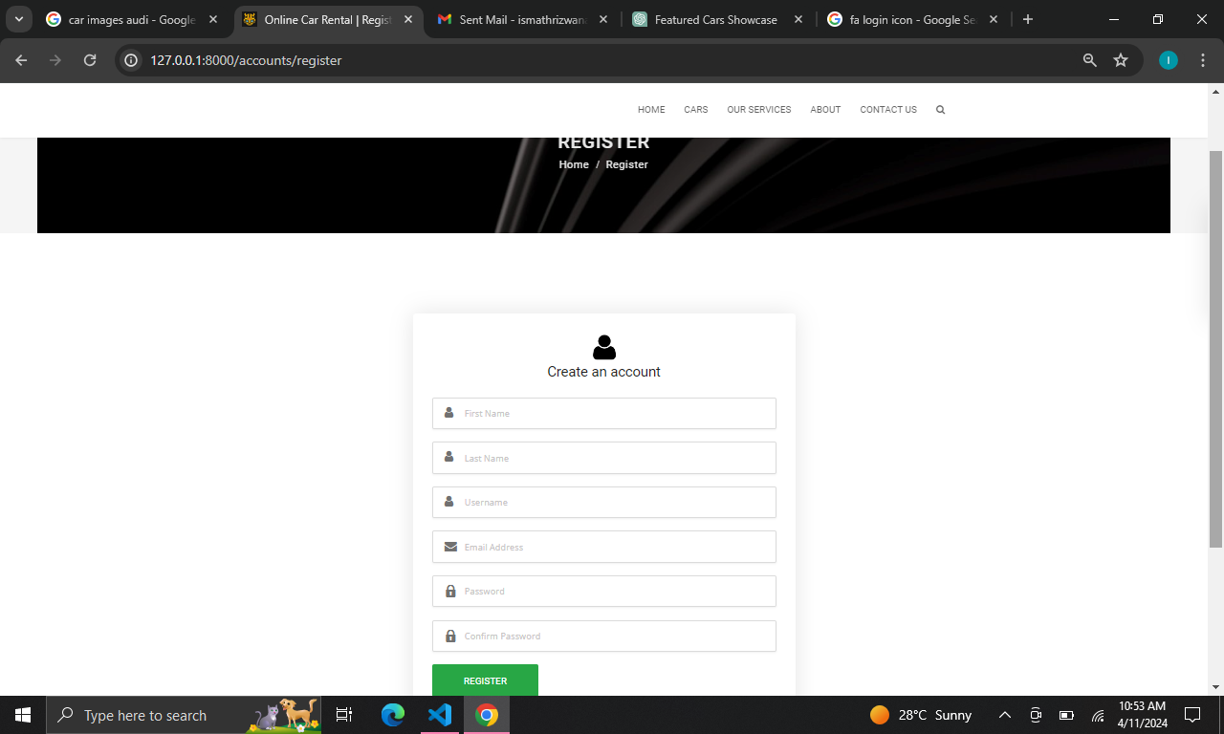
Register page

Slide 20
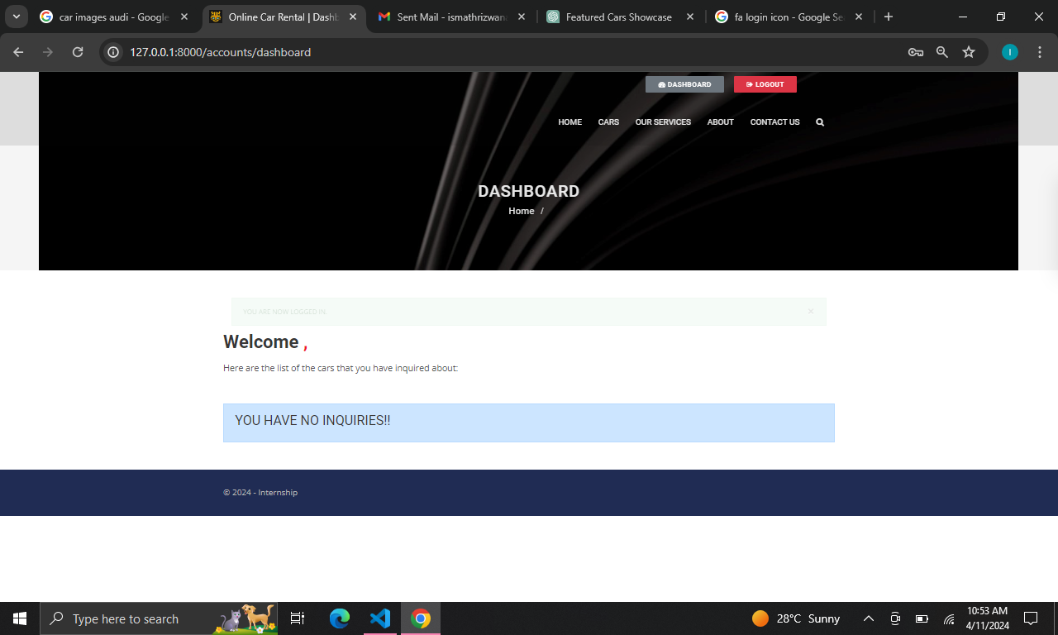
Dashboard page

Slide 21
Future Enhancements:
Implementing AI-driven features such as personalized recommendations for cars based on user preferences and past rental history can enhance user experience and increase customer satisfaction. Machine learning algorithms can also be used to optimize pricing strategies and predict demand, helping the rental business operate more efficiently.
As mobile usage continues to rise, optimizing the application for mobile devices becomes increasingly important. Developing a responsive design or even native mobile apps for iOS and Android platforms can improve accessibility and user engagement.
Introducing real-time availability updates and instant booking functionality can provide users with up-to-date information on car availability and streamline the booking process. This can be achieved through integration with external APIs or by developing custom solutions for inventory management and booking.

Slide 22
Conclusion
In conclusion, developing a car rental application using the Django framework offers numerous advantages. Django's robust features such as built-in authentication, ORM, and template engine streamline the development process, allowing for efficient creation of a secure and scalable application.
By leveraging Django's MVC architecture, developers can organize code effectively, ensuring maintainability and scalability as the project grows. Additionally, Django's extensive documentation and active community provide ample support and resources for developers at every stage of the development process.
Source :

Slide 23
Thank You!
Notes:
Thank You !!

